Slide 1
Table Occupancy system for Hawker centers
Team 12

Slide 2
Problem
Lack of information on empty tables not within the patron’s view
Poor crowd control management
Poor utilisation of seats in less obscure places
Using diners finishing their food as an indicator of them vacating the table is unreliable
Feeling of frustration
LONGER WAIT TIMES FOR TABLE

Slide 3
Where and when there are available seats?

Slide 4
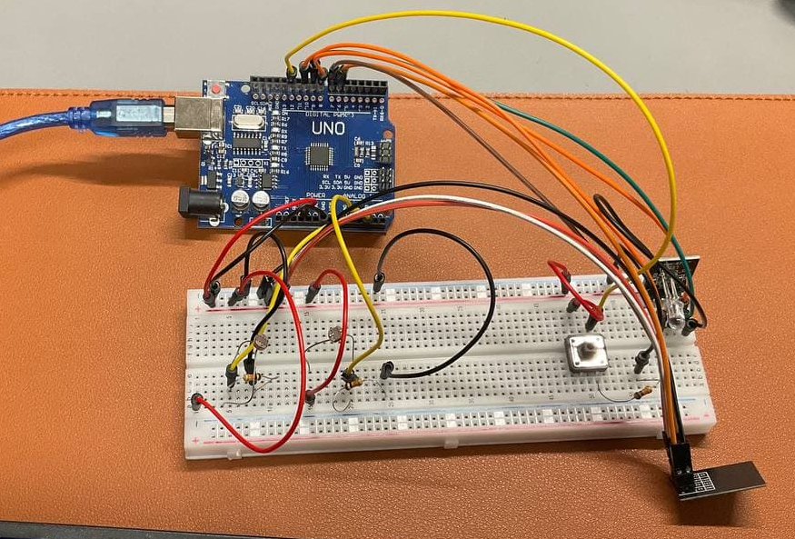
Where’s my table?
A table occupancy tracking system

Slide 5
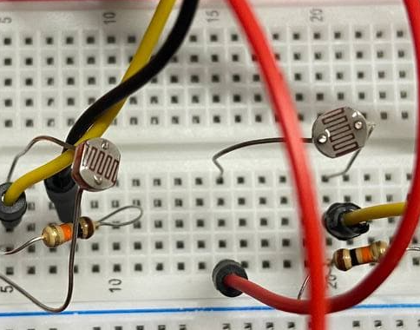
Solution - Lack of Information
Installing IR sensors on each table to track occupancy
Provide patrons with an overview of the table occupancy rate at different zones

Slide 6
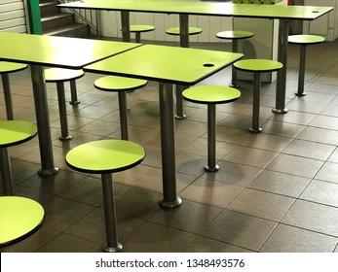
Microcontroller & IR Sensors
Direction that IR Sensor will detect if a person is sitting at the table

Slide 7
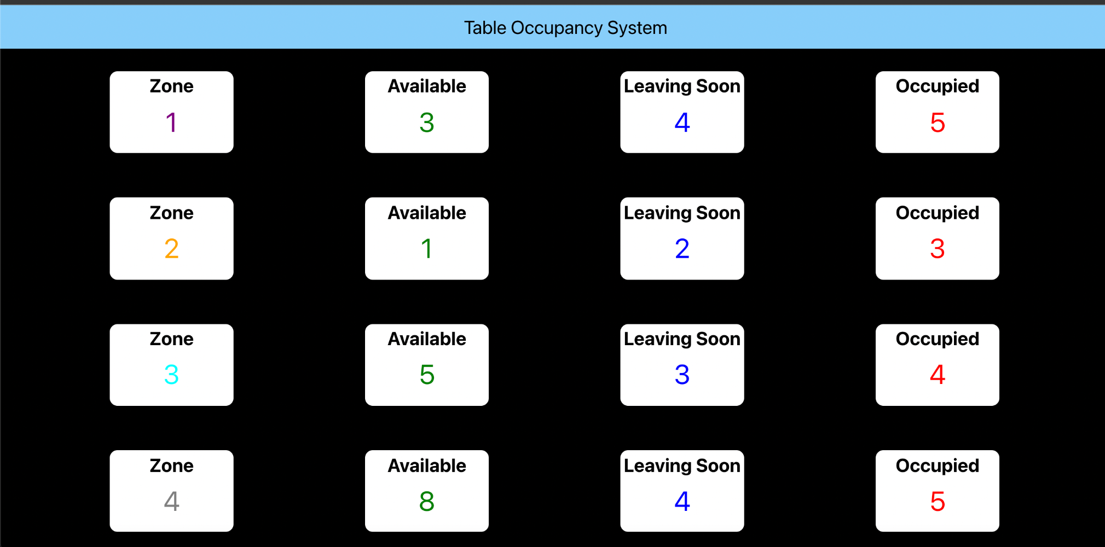
Solution - Lack of Information
Divides the hawker centers into zones
Provide real time table status to patrons

Slide 8
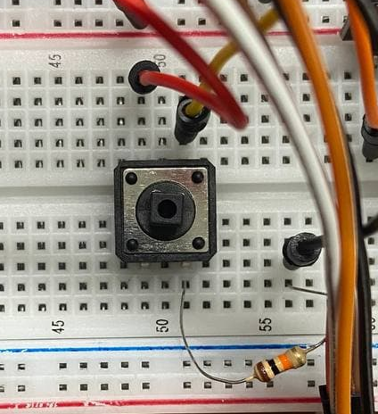
Solution - Asymmetric Information
Physical Button to allow diners to inform other patrons they are going to vacate the table soon

Slide 9
LED lights to indicate whether the table is vacant, going to be vacant or occupied
Button that patrons can press to indicate if they are leaving the table soon

Slide 10
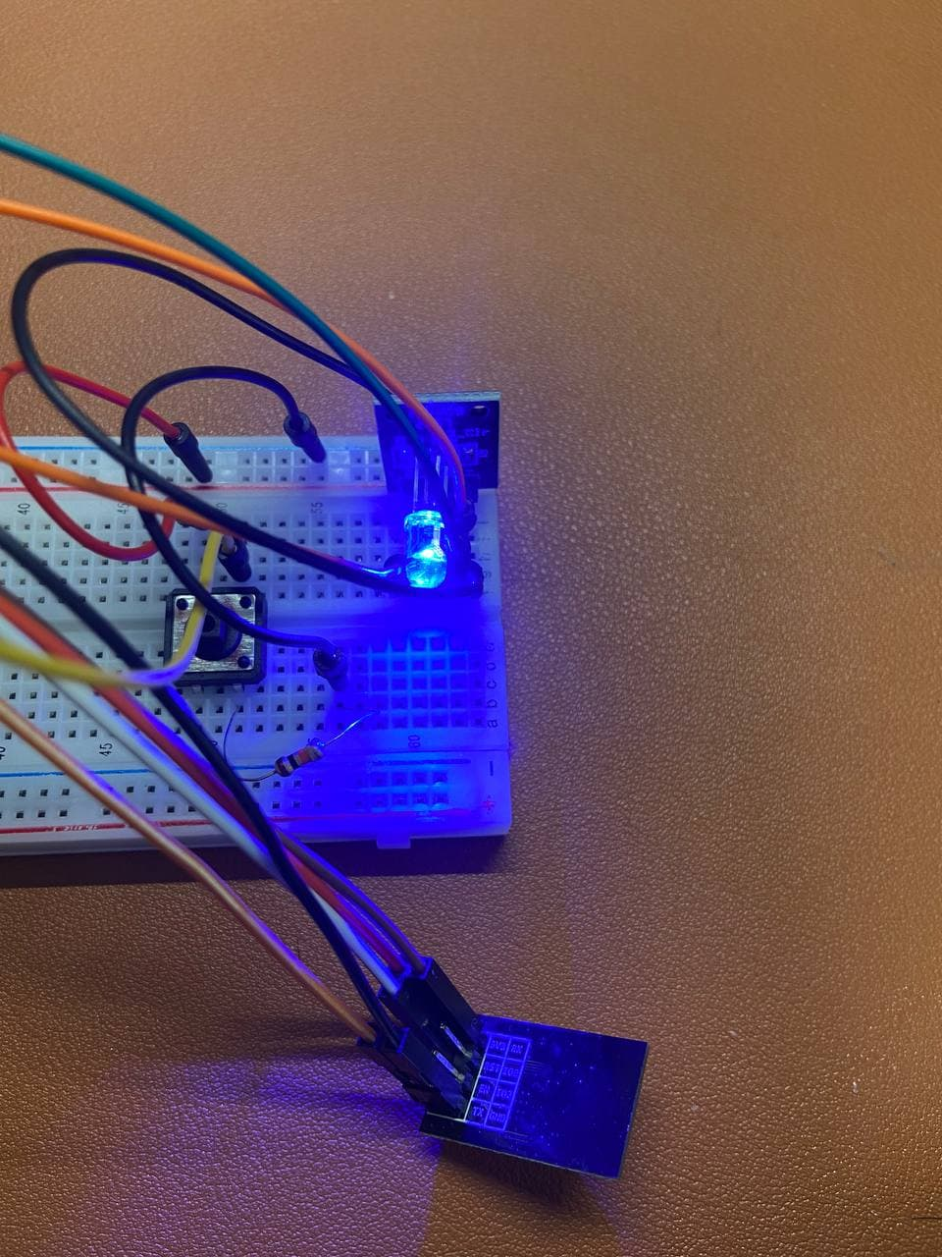
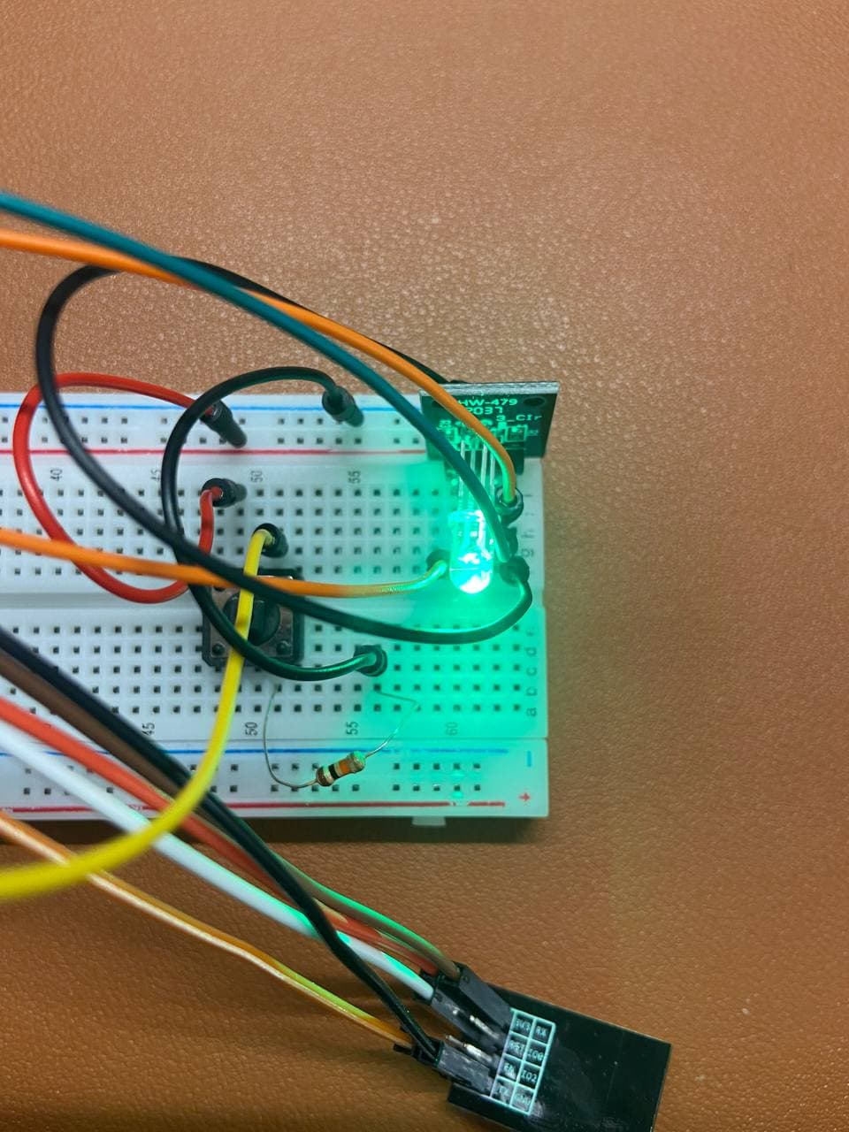
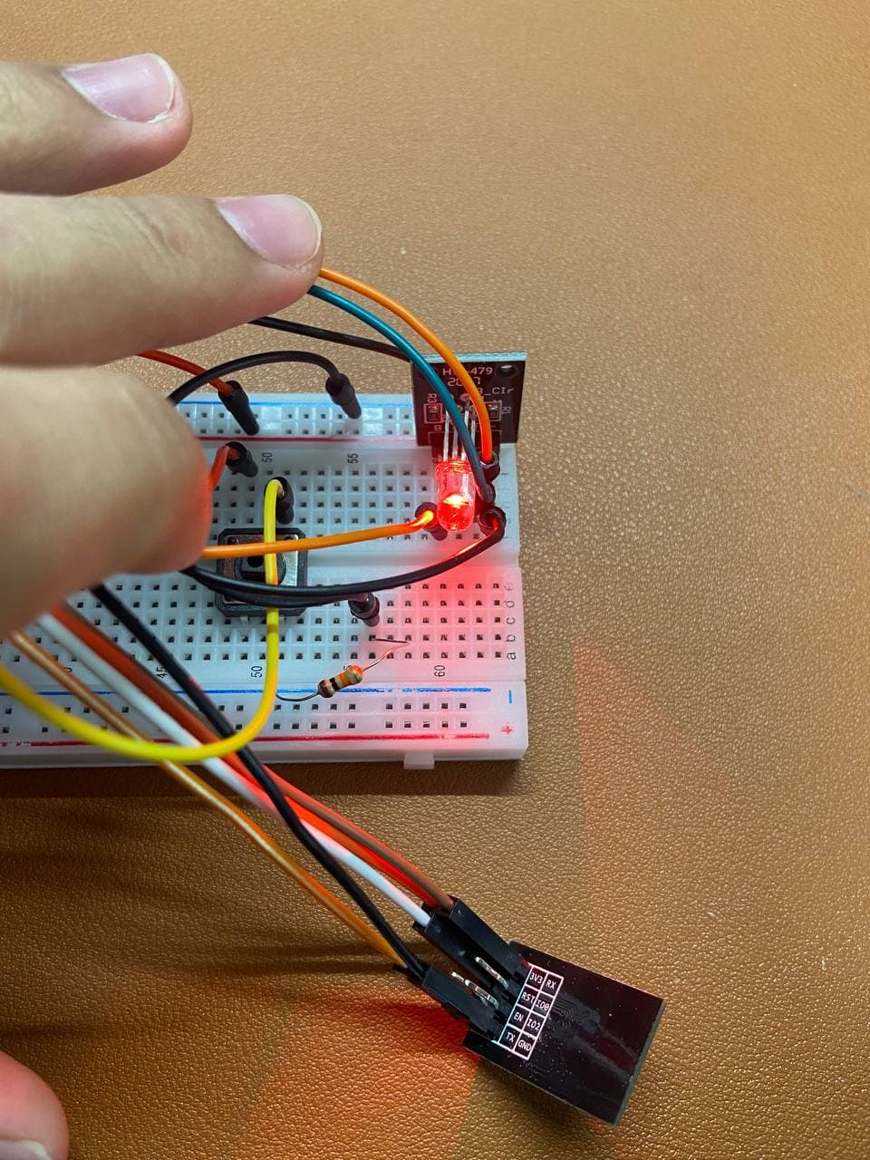
Solution - Visual Cues
Allow patrons to quickly identify which table is going to be empty soon/ or is empty
Green =Available
Red = Occupied
Blue = Available soon

Slide 11
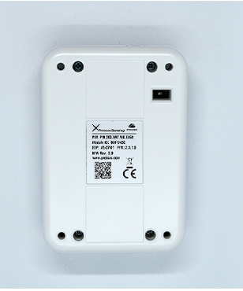
Current Market analysis
Queue Management system in restaurants, cafe
Commercial table occupancy sensors used mainly in office

Slide 12
Main Selling Points
Very feasible
Low cost & maintenance
Easy to install - not an intrusive method

Slide 13
Marketing Potential
Plenty of food centers/ hawkers centers in Singapore
Table occupancy system can be extended to other areas (Libraries, Offices, toilets etc)
Analytical data can be collected to help better plan / design interior seating spaces

Slide 14
Potential Pitfalls
Lack of actual required sensors
Restricted by the design of the tables, chairs
Abuse/ Lack of participation by patrons
Long term concerns: Batteries, degradation/ maintainability of low cost sensors

Slide 15
Future Planned upgrades
Use an IR sensor, or other type of proximity sensor
Continue miniaturising the product
Market research
Long term testing

Slide 16
Thank You!

Slide 17
Marketing Potential
Economic potential, main selling points, feasibility, competitiveness
Using patrons finishing their food as an indicator of them vacating the table is unreliable
Patrons may continue to sit at the table even after finishing their food

Slide 18
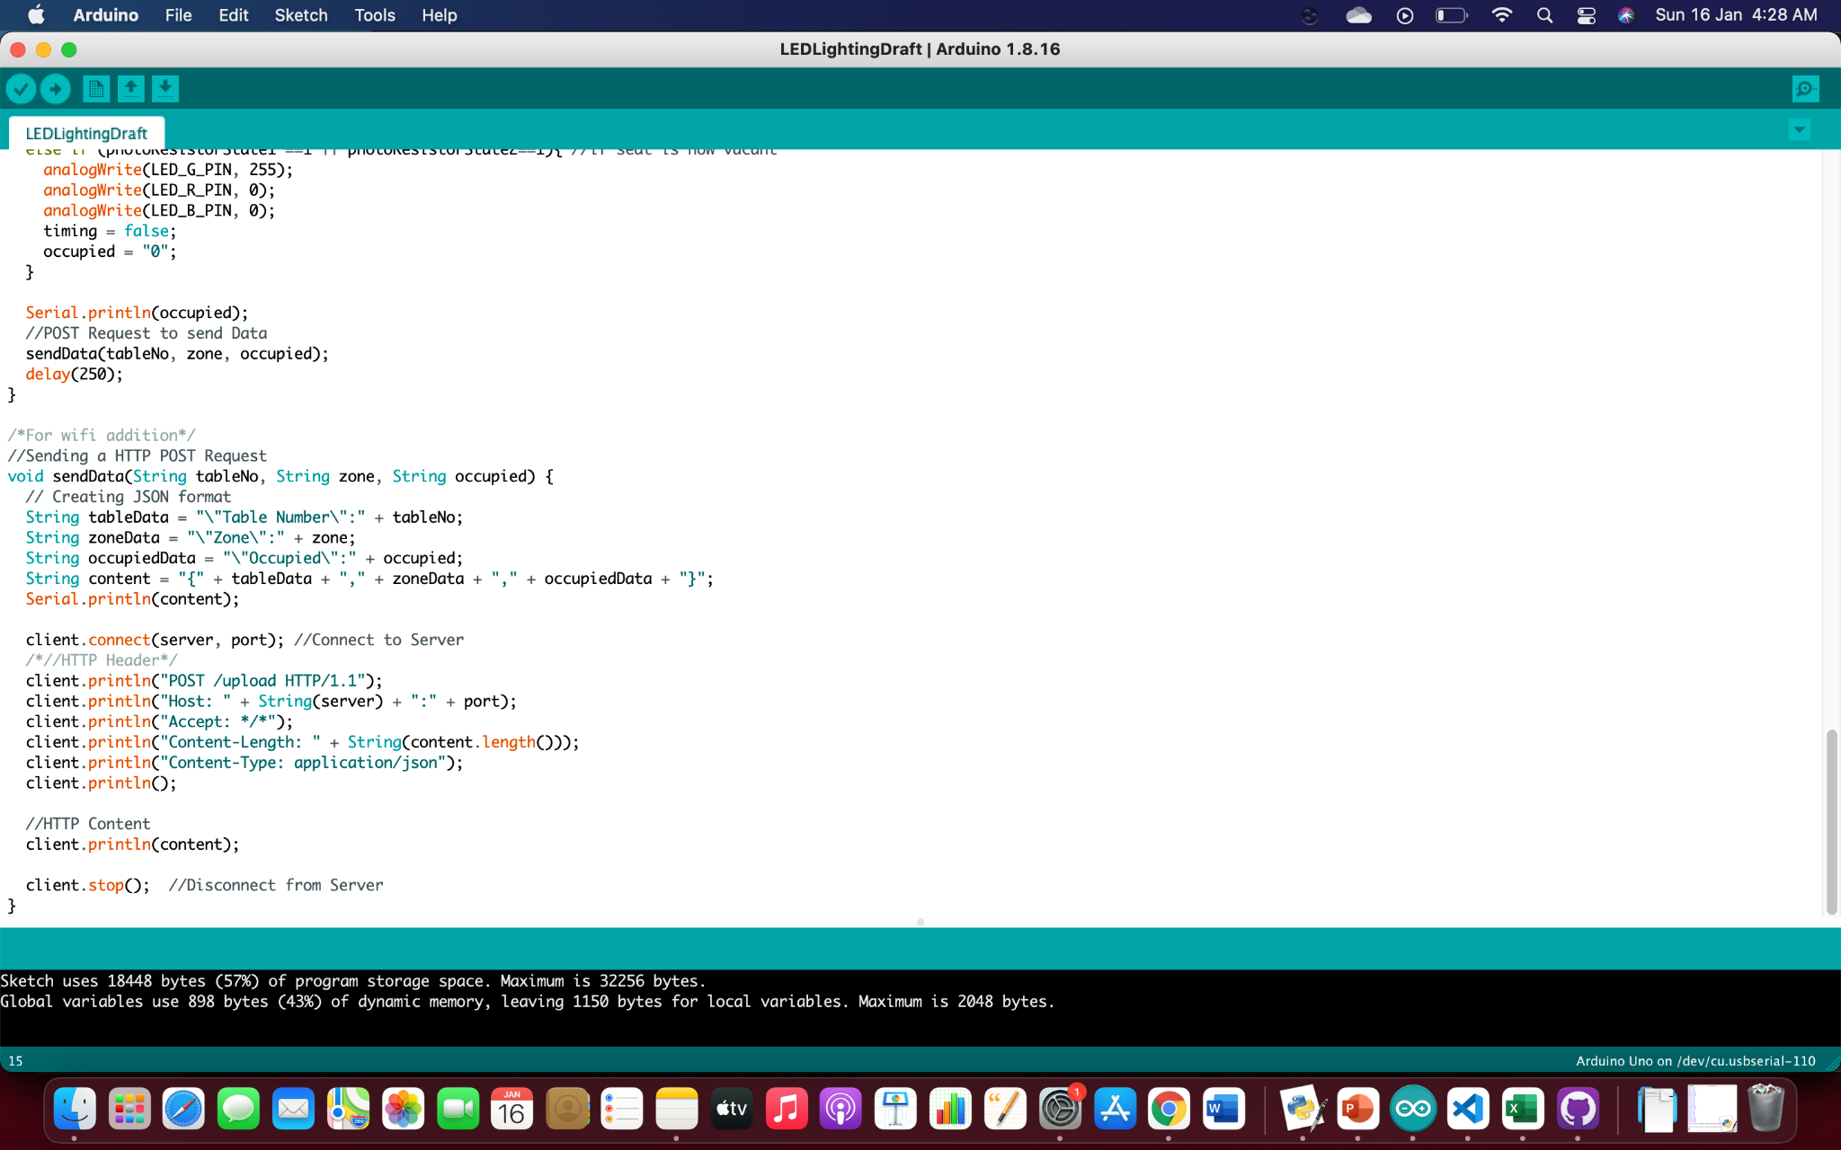
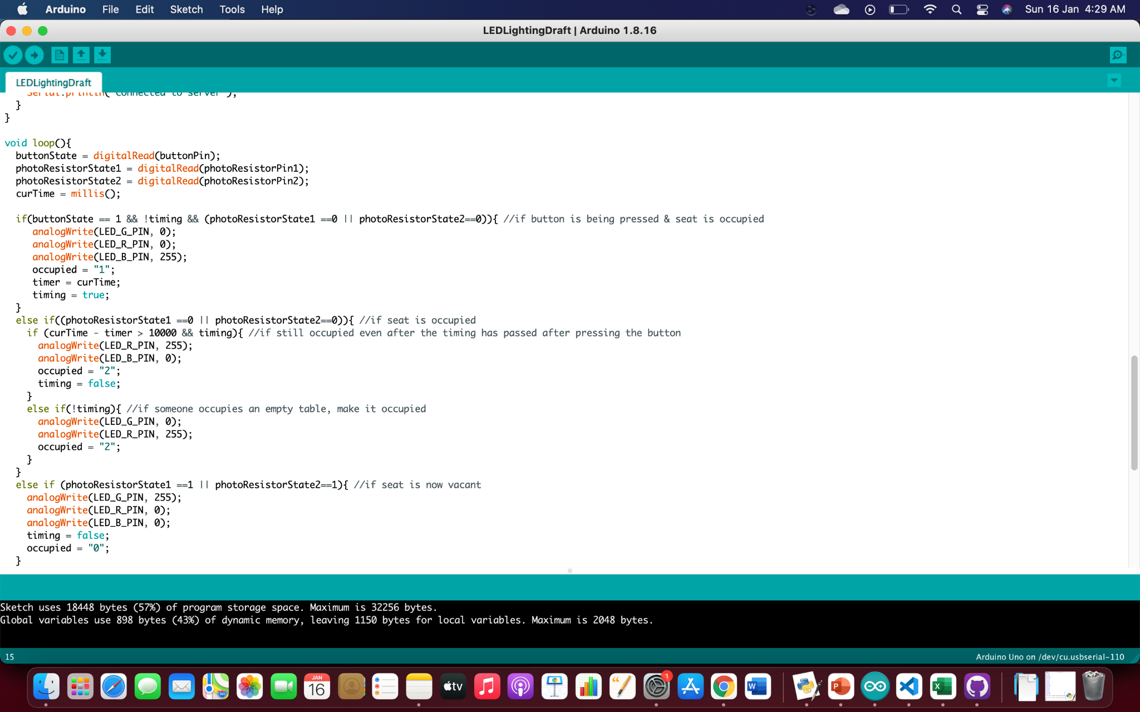

Slide 19
